Slide 1
Ocean Landforms

Slide 2
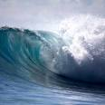
Ocean landforms can be found all around our continents.

Slide 3
70 percent of our earth is made up of oceans . The pacific ocean is the largest ocean in the world.

Slide 4
The great mass of salt water covers more than 70 percent of earth’s crust

Slide 5
Ocean landforms are formed by movement of tectonic plates.

