Slide 1
The plains

Slide 2
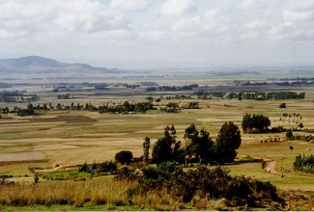
Plains are flat lands (with hills) and rich soil and are good farmland.

Slide 3
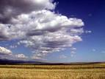
Landforms are formed by erosion, deposition and movement.

Slide 4
Plains can be found in fields grassy areas and in sandy areas.

